Slide 1
Unit 1 Data Modeling

Slide 2
Data Modeling
Entity Relationship (ER) Model
Keys
Extended ER Model
Relational Model
Codd's Rules

Slide 3
Data modeling
A data model is a collection of conceptual tools for describing data, data relationships, data semantics, and consistency constraints.
In simple terms, Data models define how the logical structure of a database is modeled that is Data models define how data is connected to each other and how they are processed and stored inside the system.
Data Models are fundamental entities to introduce abstraction in a DBMS.
Categories of Data Models
High-level or conceptual data models provide concepts that are close to the way many users perceive data.
whereas low-level or physical data models provide concepts that describe the details of how data is stored in the computer.

Slide 4
Entity Relationship (ER) Model
ER model stands for an Entity-Relationship model.
An Entity–relationship model (ER model) describes the structure of a database with the help of a diagram, which is known as Entity Relationship Diagram (ER Diagram).
An ER model is a design or blueprint of a database that can later be implemented as a database.
It is a high-level data model. This model is used to define the data elements and relationship for a specified system.
It helps developers to design the conceptual design or you can say the logical design of the system from a data perspective.
In ER modeling, the database structure is portrayed as a diagram called an entity-relationship diagram.

Slide 5
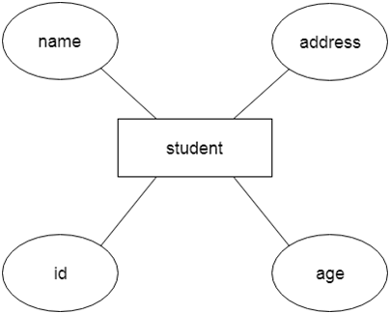
Entity Relationship (ER) Model
For example, Suppose we design a school database. In this database, the student will be an entity with attributes like address, name, id, age, etc. The address can be another entity with attributes like city, street name, pin code, etc and there will be a relationship between them.

Slide 6
Why use ER Diagrams?
Helps you to define terms related to entity relationship modeling
Provide a preview of how all your tables should connect, what fields are going to be on each table
Helps to describe entities, attributes, relationships
ER diagrams are translatable into relational tables which allows you to build databases quickly
ER diagrams can be used by database designers as a blueprint for implementing data in specific software applications
The database designer gains a better understanding of the information to be contained in the database with the help of ERP diagram
ERD Diagram allows you to communicate with the logical structure of the database to users

Slide 7
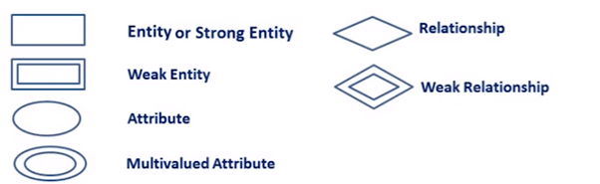

ER Diagram Symbols
Rectangles: This Entity Relationship Diagram symbol represents entity types
Double Rectangles: Weak Entity Sets
Ellipses : Symbol represent attributes
Double Ellipses: Represent multi-valued attributes
Dashed Ellipses: Derived Attributes
Diamonds: This symbol represents relationship types
Lines: It links attributes to entity types and entity types with other relationship types
Primary key: attributes are underlined

Slide 8
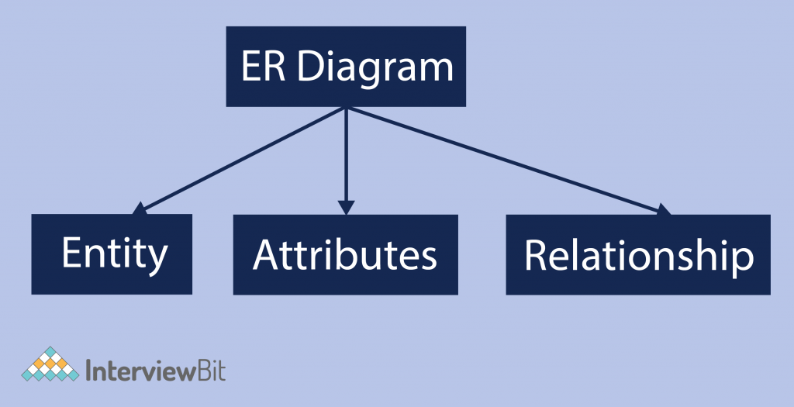
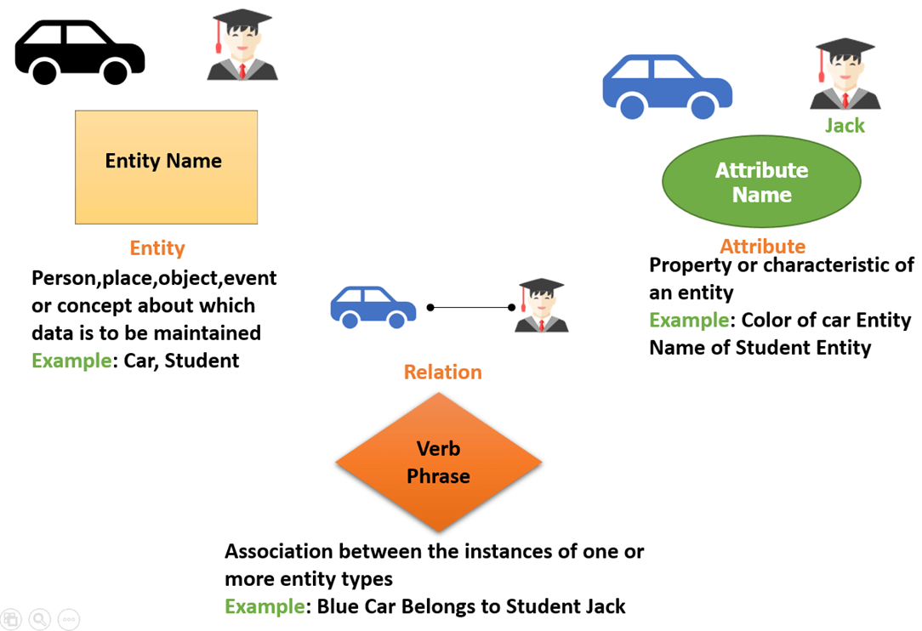
Entity Relationship (ER) Model
ER diagrams are created based on three basic concepts: entities, attributes, and relationships.

Slide 9
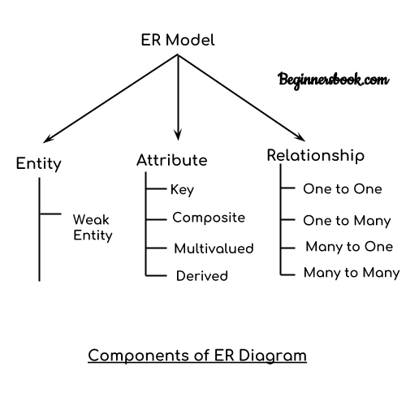

Component of ER Diagram
Entity:
An entity may be any object, class, person or place. In the ER diagram, an entity can be represented as rectangles.
For example: In the following ER diagram we have two entities Student and College and these two entities have many to one relationship as many students study in a single college.

Slide 10
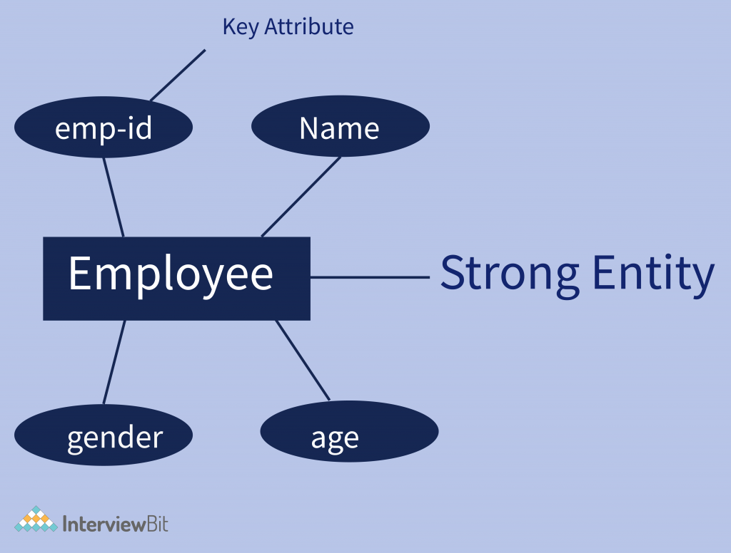
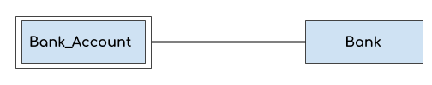
Component of ER Diagram
Strong Entity :
Strong entities are those entity types that have a key attribute.
The primary key helps in identifying each entity uniquely. This can not accept null values.
It is represented by a rectangle.
Weak Entity:
An entity that depends on another entity called a weak entity.
The weak entity doesn't contain any key attribute of its own.
The weak entity is represented by a double rectangle.
For example – a bank account cannot be uniquely identified without knowing the bank to which the account belongs, so bank account is a weak entity.

Slide 11
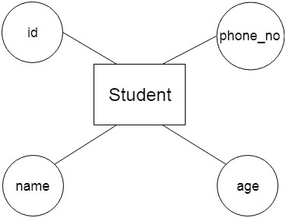
Component of ER Diagram
Attribute
An attribute describes the property of an entity. An attribute is represented as Oval/Ellipses in an ER diagram.
For example, id, age, contact number, name, etc. can be attributes of a student.
There are four types of attributes:
Key attribute
Composite attribute
Multivalued attribute
Derived attribute

Slide 12
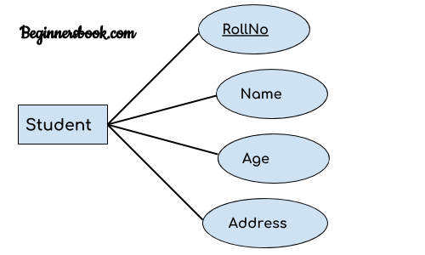
Component of ER Diagram
Attribute
1. Key attribute:
A key attribute can uniquely identify an entity from an entity set.
It represents a primary key.
For example, student roll number can uniquely identify a student from a set of students. Key attribute is represented by oval same as other attributes however the text of key attribute is underlined.

Slide 13
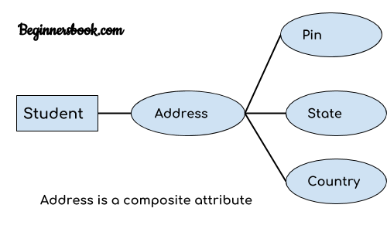
Component of ER Diagram
Attribute
2. Composite attribute:
An attribute that is a combination of other attributes is known as composite attribute.
An attribute that composed of many other attributes is known as a composite attribute.
For example, In student entity, the student address is a composite attribute as an address is composed of other attributes such as pin code, state, country.

Slide 14
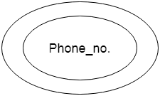
Component of ER Diagram
Attribute
3. Multivalued attribute:
An attribute that can hold multiple values is known as multivalued attribute/An attribute can have more than one value.
It is represented with double ovals in an ER Diagram.
For example – A student can have more than one phone number so the phone number attribute is multivalued.

Slide 15
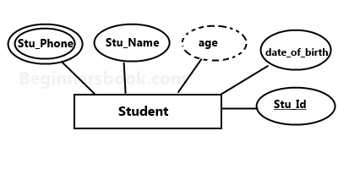
Component of ER Diagram
Attribute
4. Derived attribute:
A derived attribute is one whose value is dynamic and derived from another attribute.
It is represented by dashed oval in an ER Diagram.
For example – Person age is a derived attribute as it changes over time and can be derived from another attribute (Date of birth).

Slide 16
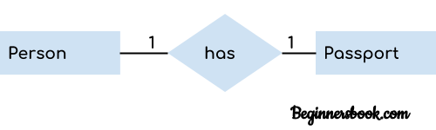
Component of ER Diagram
Attribute
A relationship is used to describe the relation between entities.
A relationship is represented by diamond shape in ER diagram.
There are four types of relationships/Cardinality
One to One
One to Many
Many to One
Many to Many
1. One to One Relationship
When a single instance of an entity is associated with a single instance of another entity then it is called one to one relationship.
For example, a person has only one passport and a passport is given to one person.

Slide 17
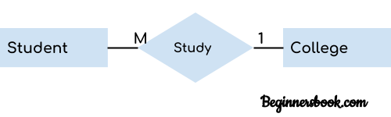

Component of ER Diagram
Attribute
2. One to Many Relationship
When only one instance of the entity on the left, and more than one instance of an entity on the right associates with the relationship then this is known as a one-to-many relationship.
For example, Scientist can invent many inventions, but the invention is done by the only specific scientist.
3. Many-to-one relationship
When more than one instance of the entity on the left, and only one instance of an entity on the right associates with the relationship then it is known as a many-to-one relationship.
For example – many students can study in a single college but a student cannot study in many colleges at the same time.

Slide 18

Component of ER Diagram
4. Many to Many Relationship
When more than one instances of an entity is associated with more than one instances of another entity then it is called many to many relationship.
For example, Employee can assign by many projects and project can have many employees.

Slide 19

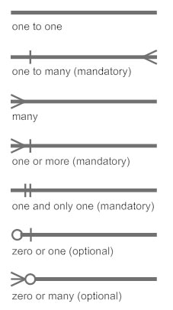
How to Create an Entity Relationship Diagram (ERD)
In a university, a Student enrolls in Courses. A student must be assigned to at least one or more Courses. Each course is taught by a single Professor. To maintain instruction quality, a Professor can deliver only one course.

Slide 20
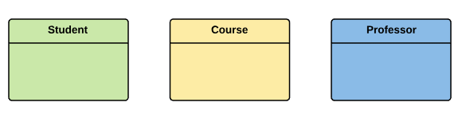
How to Create an Entity Relationship Diagram (ERD)
Step 1) Entity Identification
We have three entities
Student
Course
Professor
In a university, a Student enrolls in Courses. A student must be assigned to at least one or more Courses. Each course is taught by a single Professor. To maintain instruction quality, a Professor can deliver only one course.

Slide 21
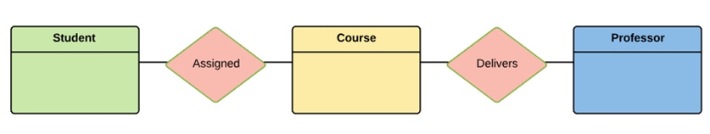
How to Create an Entity Relationship Diagram (ERD)
Step 2) Relationship Identification
We have the following two relationships
The student is assigned a course
Professor delivers a course
In a university, a Student enrolls in Courses. A student must be assigned to at least one or more Courses. Each course is taught by a single Professor. To maintain instruction quality, a Professor can deliver only one course.

Slide 22
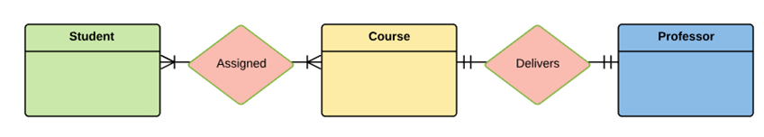
How to Create an Entity Relationship Diagram (ERD)
Step 3) Cardinality Identification
For them problem statement we know that,
A student can be assigned multiple courses
A Professor can deliver only one course
In a university, a Student enrolls in Courses. A student must be assigned to at least one or more Courses. Each course is taught by a single Professor. To maintain instruction quality, a Professor can deliver only one course.

Slide 23
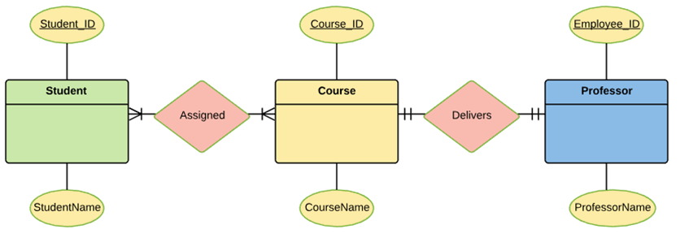
How to Create an Entity Relationship Diagram (ERD)
Entity | Primary Key | Attribute
Student | Student_ID | StudentName
Professor | Employee_ID | ProfessorName
Course | Course_ID | CourseName
Step 4) Identify Attributes
You need to study the files, forms, reports, data currently maintained by the organization to identify attributes. You can also conduct interviews with various stakeholders to identify entities. Initially, it’s important to identify the attributes without mapping them to a particular entity.
Once, you have a list of Attributes, you need to map them to the identified entities. Once the mapping is done, identify the primary Keys. If a unique key is not readily available, create one.

Slide 24
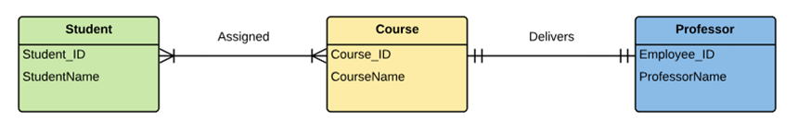
How to Create an Entity Relationship Diagram (ERD)
Entity | Primary Key | Attribute
Student | Student_ID | StudentName
Professor | Employee_ID | ProfessorName
Course | Course_ID | CourseName
Step 5) Create the ERD Diagram

Slide 25
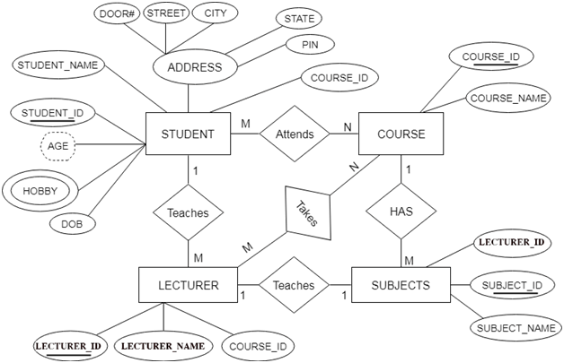
Sample ER Diagram for Student Database

Slide 26
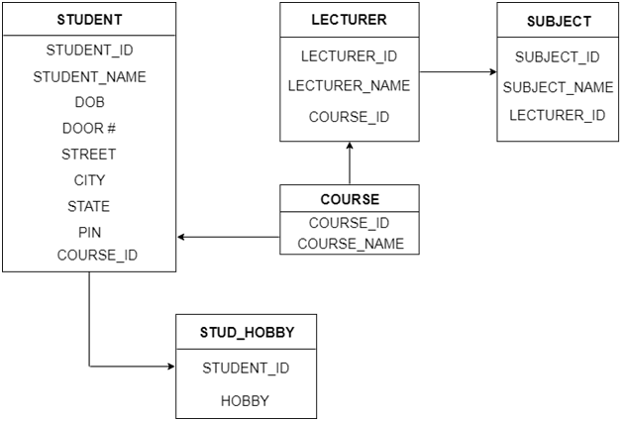
ER to Table Conversion

Slide 27
Extended ER Model
EER is a high-level data model that incorporates the extensions to the original ER model. Enhanced ERD are high level models that represent the requirements and complexities of complex database.
In addition to ER model concepts EE-R includes −
Subclasses and Super classes.
Specialization and Generalization.
Category or union type.
Aggregation.

Slide 28
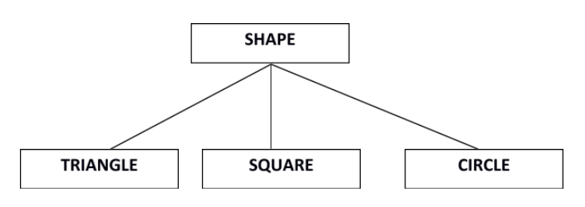
Extended ER Model
Subclasses and Super class
Super class is an entity that can be divided into further subtype.
For example − consider Shape super class.
Super class shape has sub groups: Triangle, Square and Circle.
Sub classes are the group of entities with some unique attributes.
Sub class inherits the properties and attributes from super class.

Slide 29
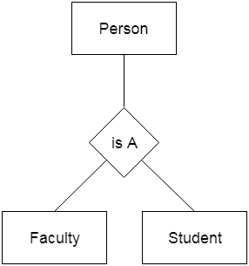
Extended ER Model
Generalization
Generalization is like a bottom-up approach in which two or more entities of lower level combine to form a higher level entity if they have some attributes in common.
Generalization is more like subclass and superclass system, but the only difference is the approach. Generalization uses the bottom-up approach.
For example, Faculty and Student entities can be generalized and create a higher level entity Person.

Slide 30
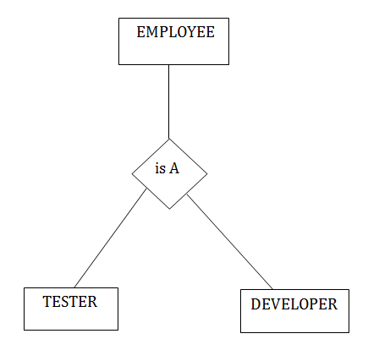
Extended ER Model
Specialization
Specialization is a top-down approach, and it is opposite to Generalization. In specialization, one higher level entity can be broken down into two lower level entities.
Specialization is used to identify the subset of an entity set that shares some distinguishing characteristics.
Normally, the superclass is defined first, the subclass and its related attributes are defined next, and relationship set are then added.
For example: In an Employee management system, EMPLOYEE entity can be specialized as TESTER or DEVELOPER based on what role they play in the company.

Slide 31
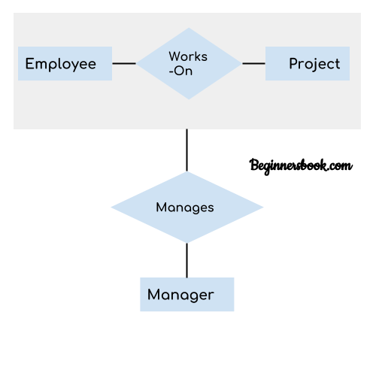
Extended ER Model
Aggregation
Aggregation is a process in which a single entity alone is not able to make sense in a relationship so the relationship of two entities acts as one entity.
Aggregation can be defined as a procedure for combining multiple entities into a single one. In database management, it is a design system performed to model relationships between a group of entities and another relationship. Its main motive is treating these relationships as a single one.
In real world, we know that a manager not only manages the employee working under them but he has to manage the project as well. In such scenario if entity “Manager” makes a “manages” relationship with either “Employee” or “Project” entity alone then it will not make any sense because he has to manage both. In these cases the relationship of two entities acts as one entity. In our example, the relationship “Works-On” between “Employee” & “Project” acts as one entity that has a relationship “Manages” with the entity “Manager”.

Slide 32
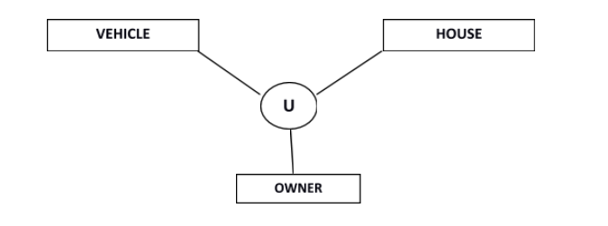
Extended ER Model
Category or Union
Relationship of one super or sub class with more than one super class.
Owner is the subset of two super class: Vehicle and House.

Slide 33
ER Model: Keys
Keys are very important part of Relational database model. They are used to establish and identify relationships between tables and also to uniquely identify any record or row of data inside a table.
A Key can be a single attribute or a group of attributes, where the combination may act as a key.
Why are the Keys Required?
It is used to uniquely identify any record or row of data from the table.
A table in a database represents a collection of records. Tables generally extends to thousands of records stored in them, unsorted and unorganized.
Now to fetch any particular record from such dataset, you will have to apply some conditions, but what if there is duplicate data present and every time you try to fetch some data by applying certain condition, you get the wrong data. How many trials before you get the right data?
To avoid all this, Keys are defined to easily identify any row of data in a table.

Slide 34
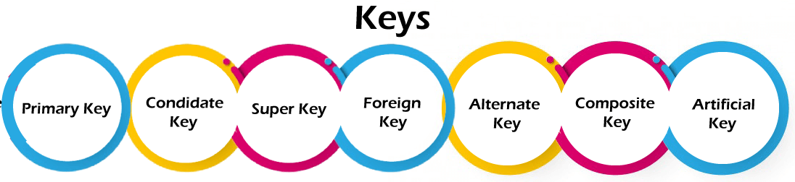
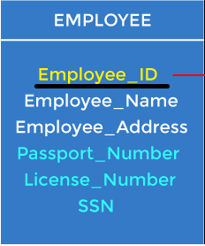
ER Model : Types of Keys
Primary Key
It is the first key used to identify one and only one instance of an entity uniquely. An entity can contain multiple keys.
In the EMPLOYEE table, ID can be the primary key since it is unique for each employee. In the EMPLOYEE table, we can even select License_Number and Passport_Number as primary keys since they are also unique.
For each entity, the primary key selection is based on requirements and developers.

Slide 35
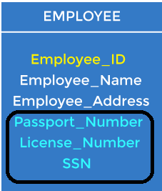
ER Model : Types of Keys
2. Candidate key
A candidate key is an attribute or set of attributes that can uniquely identify a tuple.
Except for the primary key, the remaining attributes are considered a candidate key. The candidate keys are as strong as the primary key.
For example: In the EMPLOYEE table, id is best suited for the primary key. The rest of the attributes, like SSN, Passport_Number, License_Number, etc., are considered a candidate key.
Primary key column value can not be null, Candidate key column can have null value.

Slide 36
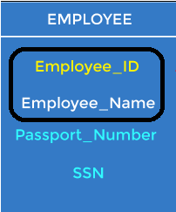
ER Model : Types of Keys
3. Super Key
Super key is an attribute set that can uniquely identify a tuple. A super key is a superset of a candidate key.
The super key would be EMPLOYEE-ID (EMPLOYEE_ID, EMPLOYEE-NAME), etc.
It is the superset of all such attributes that can uniquely identify the table. It is the subset or the part of the Super key.

Slide 37
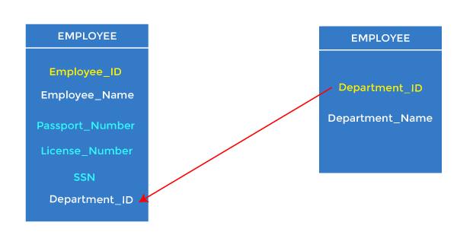
ER Model : Types of Keys
4. Foreign key
Foreign keys are the column of the table used to point to the primary key of another table.
Every employee works in a specific department in a company, and employee and department are two different entities. So we can't store the department's information in the employee table. That's why we link these two tables through the primary key of one table.
We add the primary key of the DEPARTMENT table, Department_Id, as a new attribute in the EMPLOYEE table.
In the EMPLOYEE table, Department_Id is the foreign key, and both the tables are related.

Slide 38
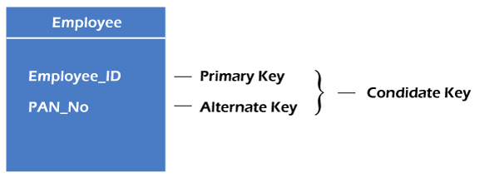
ER Model : Types of Keys
5. Alternate key
The candidate key which are not selected as primary key are known as secondary keys or alternative keys.
One key is chosen as the primary key from candidate keys, and the remaining candidate key, if it exists, is termed the alternate key. In other words, the total number of the alternate keys is the total number of candidate keys minus the primary key.
For example, employee relation has two attributes, Employee_Id and PAN_No, that act as candidate keys. In this relation, Employee_Id is chosen as the primary key, so the other candidate key, PAN_No, acts as the Alternate key.

Slide 39
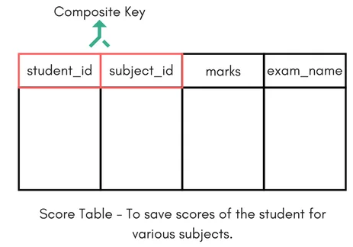
ER Model : Types of Keys
6. Composite key
Whenever a primary key consists of more than one attribute, it is known as a composite key. This key is also known as Concatenated Key.
But the attributes which together form the Composite key are not a key independently or individually.
For example, Score table which stores the marks scored by a student in a particular subject.
In this table student_id and subject_id together will form the primary key, hence it is a composite key.

Slide 40
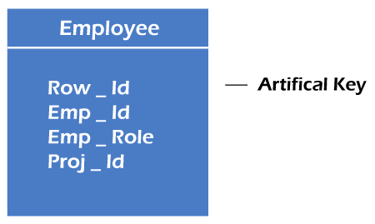
ER Model : Types of Keys
7. Artificial key
The key created using arbitrarily assigned data are known as artificial keys. These keys are created when a primary key is large and complex and has no relationship with many other relations.
The data values of the artificial keys are usually numbered in a serial order.
For example, the primary key, which is composed of Emp_ID, Emp_role, and Proj_ID, is large in employee relations. So it would be better to add a new virtual attribute to identify each tuple in the relation uniquely.

Slide 41
Relational Model
Relational Model was proposed by E.F. Codd to model data in the form of relations or tables.
After designing the conceptual model of Database using ER diagram, we need to convert the conceptual model in the relational model which can be implemented using any RDBMS languages like Oracle SQL, MySQL etc.
Relational Model represents how data is stored in Relational Databases. A relational database stores data in the form of relations (tables).

Slide 42
Relational Model
ROLL_NO | NAME | ADDRESS | PHONE | AGE
1 | RAM | DELHI | 9455123451 | 18
2 | RAMESH | GURGAON | 9652431543 | 18
3 | SUJIT | ROHTAK | 9156253131 | 20
4 | SURESH | DELHI |  | 18
Consider a relation STUDENT with attributes
ROLL_NO, NAME, ADDRESS, PHONE and AGE shown in Table.
IMPORTANT TERMINOLOGIES
Attribute: Attributes are the properties that define a relation. e.g.; ROLL_NO, NAME
Relation Schema: A relation schema represents name of the relation with its attributes. e.g.; STUDENT (ROLL_NO, NAME, ADDRESS, PHONE and AGE) is relation schema for STUDENT. If a schema has more than 1 relation, it is called Relational Schema.
Tuple: Each row in the relation is known as tuple. The above relation contains 4 tuples, one of which is shown as:
1 | RAM | DELHI | 9455123451 | 18

Slide 43
Relational Model
ROLL_NO | NAME | ADDRESS | PHONE | AGE
1 | RAM | DELHI | 9455123451 | 18
2 | RAMESH | GURGAON | 9652431543 | 18
3 | SUJIT | ROHTAK | 9156253131 | 20
4 | SURESH | DELHI |  | 18
Relation Instance: The set of tuples of a relation at a particular instance of time is called as relation instance. Table shows the relation instance of STUDENT at a particular time. It can change whenever there is insertion, deletion or updation in the database.
Degree: The number of attributes in the relation is known as degree of the relation. The STUDENT relation defined above has degree 5.
Cardinality: The number of tuples in a relation is known as cardinality. The STUDENT relation defined above has cardinality 4.
Column: Column represents the set of values for a particular attribute. The column ROLL_NO is extracted from relation STUDENT.
NULL Values: The value which is not known or unavailable is called NULL value. It is represented by blank space. e.g.; PHONE of STUDENT having ROLL_NO 4 is NULL.
ROLL_NO
1
2
3
4

Slide 44
Relational Model
ROLL_NO | NAME | ADDRESS | PHONE | AGE
1 | RAM | DELHI | 9455123451 | 18
2 | RAMESH | GURGAON | 9652431543 | 18
3 | SUJIT | ROHTAK | 9156253131 | 20
4 | SURESH | DELHI |  | 18
Constraints in Relational Model
While designing Relational Model, we define some conditions which must hold for data present in database are called Constraints. These constraints are checked before performing any operation (insertion, deletion and updation) in database. If there is a violation in any of constrains, operation will fail.
Domain Constraints: These are attribute level constraints. An attribute can only take values which lie inside the domain range. e.g,; If a constrains AGE>0 is applied on STUDENT relation, inserting negative value of AGE will result in failure.
Key Integrity: Every relation in the database should have at least one set of attributes which defines a tuple uniquely. Those set of attributes is called key. e.g.; ROLL_NO in STUDENT is a key. No two students can have same roll number. So a key has two properties:
It should be unique for all tuples.
It can’t have NULL values.

Slide 45
Relational Model
Constraints in Relational Model
Referential Integrity: When one attribute of a relation can only take values from other attribute of same relation or any other relation, it is called referential integrity. Let us suppose we have 2 relations
STUDENT
BRANCH
ROLL_NO | NAME | ADDRESS | PHONE | AGE | BRANCH_CODE
1 | RAM | DELHI | 9455123451 | 18 | CS
2 | RAMESH | GURGAON | 9652431543 | 18 | CS
3 | SUJIT | ROHTAK | 9156253131 | 20 | ECE
4 | SURESH | DELHI |  | 18 | IT
BRANCH_CODE | BRANCH_NAME
CS | COMPUTER SCIENCE
IT | INFORMATION TECHNOLOGY
ECE | ELECTRONICS AND COMMUNICATION ENGINEERING
CV | CIVIL ENGINEERING
BRANCH_CODE of STUDENT can only take the values which are present in BRANCH_CODE of BRANCH which is called referential integrity constraint.
The relation which is referencing to other relation is called REFERENCING RELATION (STUDENT in this case) and the relation to which other relations refer is called REFERENCED RELATION (BRANCH in this case).

Slide 46
Relational Model
ANOMALIES
An anomaly is an irregularity, or something which deviates from the expected or normal state. When designing databases, we identify three types of anomalies: Insert, Update and Delete.
Insertion Anomaly in Referencing Relation:
We can’t insert a row in REFERENCING RELATION if referencing attribute’s value is not present in referenced attribute value. e.g.; Insertion of a student with BRANCH_CODE ‘ME’ in STUDENT relation will result in error because ‘ME’ is not present in BRANCH_CODE of BRANCH.
Deletion/ Updation Anomaly in Referenced Relation:
We can’t delete or update a row from REFERENCED RELATION if value of REFERENCED ATTRIBUTE is used in value of REFERENCING ATTRIBUTE. e.g; if we try to delete tuple from BRANCH having BRANCH_CODE ‘CS’, it will result in error because ‘CS’ is referenced by BRANCH_CODE of STUDENT, but if we try to delete the row from BRANCH with BRANCH_CODE CV, it will be deleted as the value is not been used by referencing relation. It can be handled by following method:
ON DELETE CASCADE: It will delete the tuples from REFERENCING RELATION if value used by REFERENCING ATTRIBUTE is deleted from REFERENCED RELATION. e.g;, if we delete a row from BRANCH with BRANCH_CODE ‘CS’, the rows in STUDENT relation with BRANCH_CODE CS (ROLL_NO 1 and 2 in this case) will be deleted.
ON UPDATE CASCADE: It will update the REFERENCING ATTRIBUTE in REFERENCING RELATION if attribute value used by REFERENCING ATTRIBUTE is updated in REFERENCED RELATION. e.g;, if we update a row from BRANCH with BRANCH_CODE ‘CS’ to ‘CSE’, the rows in STUDENT relation with BRANCH_CODE CS (ROLL_NO 1 and 2 in this case) will be updated with BRANCH_CODE ‘CSE’.
REFERENCING RELATION (STUDENT in this case)
REFERENCED RELATION (BRANCH in this case)

Slide 47
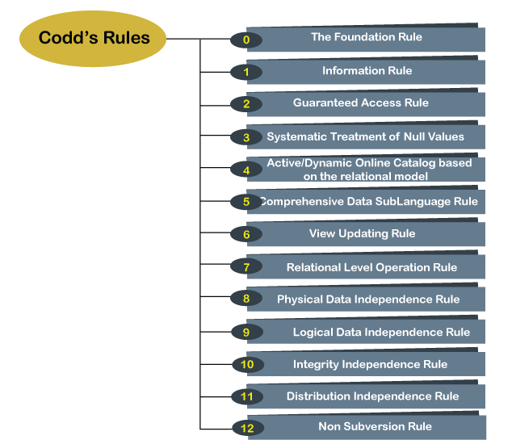
Codd's Rules
E.F Codd was a Computer Scientist who invented the Relational model for Database management. Based on relational model, the Relational database was created.
Dr Edgar F. Codd, after his extensive research on the Relational Model of database systems, came up with twelve rules of his own, which according to him, a database must obey in order to be regarded as a true relational database.
These rules can be applied on any database system that manages stored data using only its relational capabilities.
This is a foundation rule, which acts as a base for all the other rules.

Slide 48
Codd's Rules
Rule 0: The Foundation Rule
The database must be in relational form. So that the system can handle the database through its relational capabilities.
Rule 1: Information Rule
A database contains various information, and this information must be stored in each cell of a table in the form of rows and columns.
Rule 2: Guaranteed Access Rule
Every single or precise data (atomic value) may be accessed logically from a relational database using the combination of primary key value, table name, and column name.
Rule 3: Systematic Treatment of Null Values
This rule defines the systematic treatment of Null values in database records. The null value has various meanings in the database, like missing the data, no value in a cell, inappropriate information, unknown data and the primary key should not be null.

Slide 49
Codd's Rules
Rule 4: Active/Dynamic Online Catalog based on the relational model
It represents the entire logical structure of the descriptive database that must be stored online and is known as a database dictionary. It authorizes users to access the database and implement a similar query language to access the database.
Rule 5: Comprehensive Data Sub Language Rule
The relational database supports various languages, and if we want to access the database, the language must be the explicit, linear or well-defined syntax, character strings and supports the comprehensive: data definition, view definition, data manipulation, integrity constraints, and limit transaction management operations. If the database allows access to the data without any language, it is considered a violation of the database.
Rule 6: View Updating Rule
All views table can be theoretically updated and must be practically updated by the database systems.
Rule 7: Relational Level Operation (High-Level Insert, Update and delete) Rule
A database system should follow high-level relational operations such as insert, update, and delete in each level or a single row. It also supports union, intersection and minus operation in the database system.

Slide 50
Codd's Rules
Rule 8: Physical Data Independence Rule
All stored data in a database or an application must be physically independent to access the database. Each data should not depend on other data or an application. If data is updated or the physical structure of the database is changed, it will not show any effect on external applications that are accessing the data from the database.
Rule 9: Logical Data Independence Rule
It is similar to physical data independence. It means, if any changes occurred to the logical level (table structures), it should not affect the user's view (application). For example, suppose a table either split into two tables, or two table joins to create a single table, these changes should not be impacted on the user view application.
Rule 10: Integrity Independence Rule
The database should be able to enforce its own integrity rather than using other programs. Key and Check constraints, trigger etc, should be stored in Data Dictionary. All entered values should not be changed or rely on any external factor or application to maintain integrity. This also make RDBMS independent of front-end.

Slide 51
Codd's Rules
Rule 11: Distribution Independence Rule
The distribution independence rule represents a database that must work properly, even if it is stored in different locations and used by different end-users. Suppose a user accesses the database through an application; in that case, they should not be aware that another user uses particular data, and the data they always get is only located on one site. This lays the foundation of distributed database.
Rule 12: Non Subversion Rule
The non-subversion rule defines RDBMS as a SQL language to store and manipulate the data in the database. If a system has a low-level or separate language other than SQL to access the database system, it should not subvert or bypass integrity to transform data.

